Slide 1
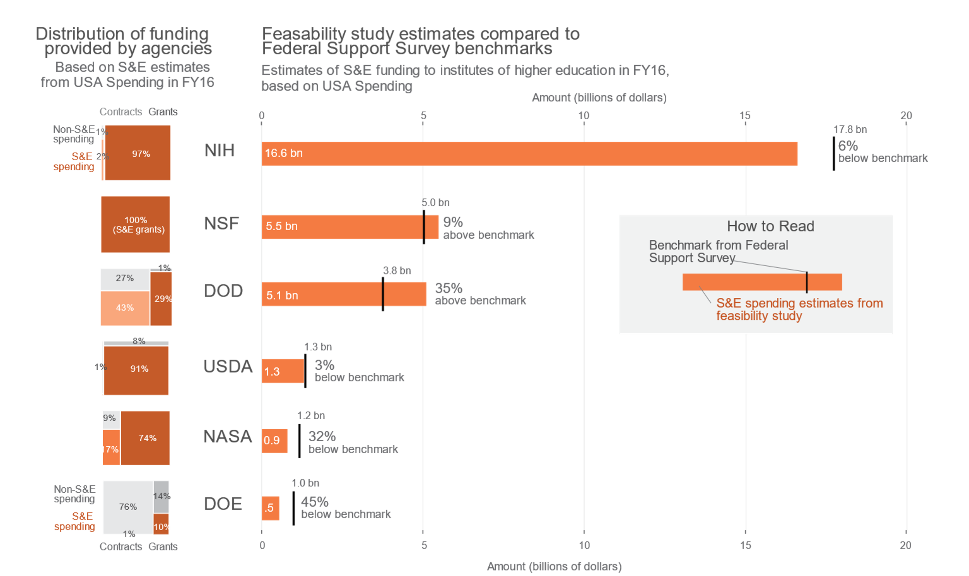

Measuring the public funding of R&d:
A feasibility study
DSPG: Sean Pietrowicz, Alyssa Fowers
Mentors: Joel Thurston, Samantha Cohen, Stephanie Shipp
Sponsor: John Jankowski, Chris Pece, Gary Anderson, Audrey Kindlon, NCSES
Biocomplexity Institute, University of Virginia
Can we estimate government spending on research and development using publicly available administrative data?
Research and Development (R&D) is basic and applied research and technological development. R&D is a subset of Science and Engineering (S&E), which also includes training, conferences, and fellowships.
We examined spending from 6 federal agencies in fiscal year 2016 to determine the feasibility of identifying transactions related to S&E and R&D. These 6 agencies (DOD, DOE, USDA, NASA, NIH, NSF) accounted for 97% of all R&D funding in the 2016 fiscal year.
Methods: Identifying Science and Engineering funding in USA Spending
Data Source: USA Spending
Maintained by Treasury Department, Bureau of the Fiscal Service since 2008
Dataset includes all transactions between federal government and institutions of higher education in FY 2016
174,377 grant-related transactions
126,617 contract-related transactions
Catalog of Federal Domestic Assistance (CFDA) numbers explain intended use of grants. CFDA codes could identify S&E, but not specifically R&D.
Benchmarking: The Federal Support Survey (FSS)
The Survey of Federal Science and Engineering Support to Universities, Colleges, and Nonprofit Institutions (FSS) is run by the NCSES
Yearly census of R&D and S&E funding; used FY 2016 data in analysis
Product & Service Codes (PSC) classify contracts by purpose (including R&D)
Results
Checking Our Work
Conclusions
Yes, it is feasible to estimate R&D spending with publicly available data. Using project funding indicators in USA Spending, we produced estimates of S&E funding similar to those in the FSS.
Future Work
Refine and measure subtypes of S&E and R&D
Use additional microdata, e.g. abstracts, to assess whether basic, applied, and development research can be identified
Examine agency-specific databases to fill in additional information beyond USA Spending
Federal RePORTER is an NIH-run public database of R&D funding: accurate, but not comprehensive
Used as a sample of R&D grants to test accuracy of our classification method
Result:
The Classification method
identified 99.9% of the
R&D grants found in
Federal RePORTER.
Identified as S&E in
USA Spending
No Yes
Found in Federal Reporter
Yes No
69,932 | 19,252
93 | 3759
SOCIAL AND DECISION ANALYTICS DIVISION

